Slide 1
Chapter 6 Filters

Slide 2
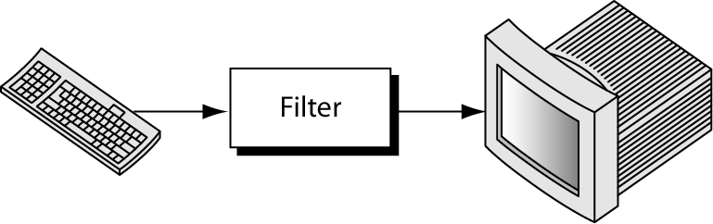
Introduction
A filter is any command that gets its input from the standard input stream, manipulates the input, and sends the result to the standard output stream.
Some filters can receive data directly from a file.
The more command is a filter.

Slide 3
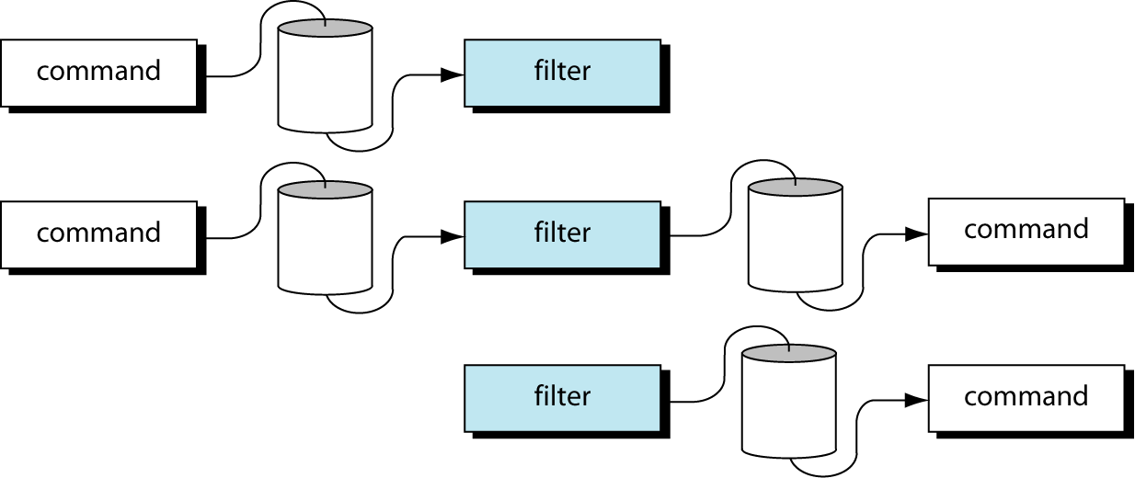
Using Filter with Pipe
Filters work naturally with pipes.
A filter can be used on the left of a pipe, between two pipes, and on the right of a pipe.

Slide 4
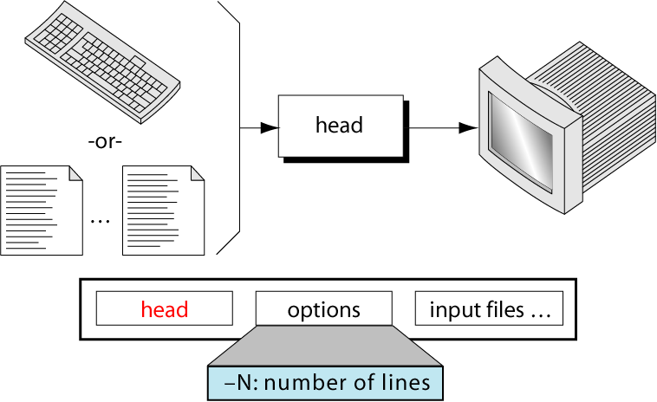
head command
The head command copies N (10 by default) lines from the beginning of one or more files to standard output.
The option is used to specify the number of lines. If the number of lines is larger than the total number of lines in the file, the total file is used.
If no files are specified, it gets the lines from standard input.

Slide 5
head command
Example 1: Display first 2 line of file “Hello.txt”
$ head -2 hello.txt
Hi
Good Morning
Example 2: Display first 2 line of file “Hello.txt” and “Sample.txt”
$ head -2 hello.txt sample.txt
== > hello.txt< ==
Hi
Good Morning
== > sample.txt < ==
Head command example

Slide 6
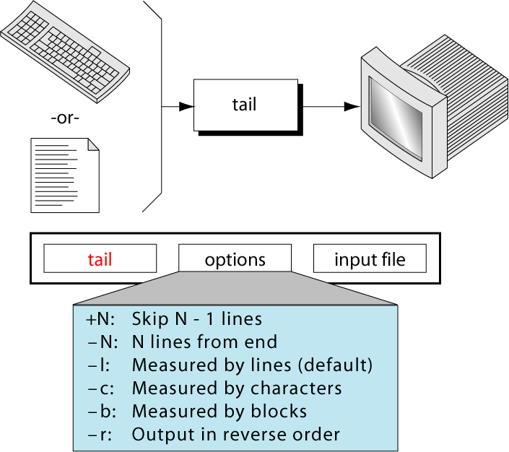
tail command
The tail command outputs the data from the end of the file.

Slide 7
tail command
If the option start with + sign, tail skip “N-1” line before it begins to output lines from the file and continues until it gets to the end of file.
If it start with “-” sign, such as -25, it outputs the last number of lines specified in the option.
If there are no line option, the default is the last 10 lines.
OPTION | CODE | DESCRIPTION
Count from beginning | +N | Skip N-1 line, copies rest to EOF.
Count from end | -N | Copies last N lines.
Count by lines | -l | Count by line.
Count by characters | -c | Counts by character.
Count by block | -b | Count by disk block.
Reverse order | -r | Output in reverse order.

Slide 8
tail command
Example 1: Display last 10 lines
$ tail example.txt
Example 2: Display last 2 lines
$ tail -2 example.txt
dedicated hosting server
cloud servers
Example 3: Display the last 8 character or byte from file
$ tail –c8 example.txt

Slide 9
tail command
Example 4: Display line from 8 to 12 from the file. OR Extract line from middle of file.
$ head -12 example.txt | tail +8
Here head command extract first 12 line and output of it pipe to the tail command to extract line from 8 to eof.

Slide 10
tail command
Example 5: Display file data from line number 9.
$ tail +9 example.txt
Here tail command skip first 8 line and display all lines of file till eof.

Slide 11
tail command
Example 6: Display line from 8 to 12 from the file. OR Extract line from middle of file using “TAIL” filter
$ tail +8 example.txt | head -5
Here tail command skip first 7 line and give all lines of file till eof. This output is used as input in command “head” which print first five line from it.

Slide 12
tail command
Example 7: Display the file from 9 character or 9 th byte of file.
$ tail –c+8 example.txt
It print file from 8th character.

Slide 13
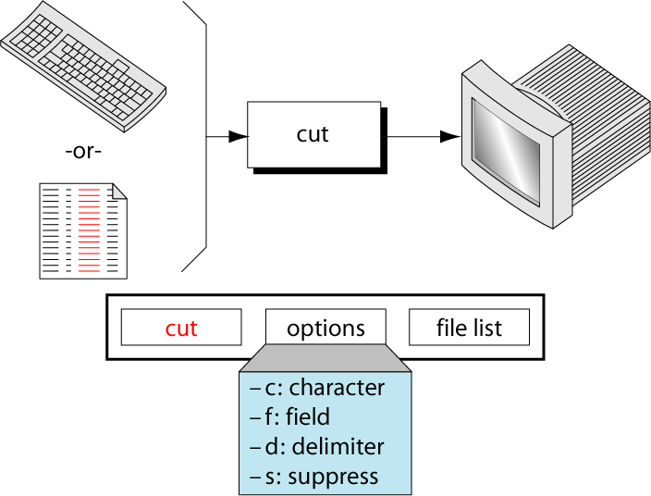
cut command
Use to extract one or more columns of data from standard input from one or more files.
Similar to head and tail command, but “cut” command cut files vertically whereas “head” and “tail” cut files horizontally.

Slide 14
cut command
Because it works on columns, we need a data file that organizes data with several related elements on each line.
To demonstrate the use of cut command first create a file “test.txt”, with comma as delimiter.
$ cat test.txt
Rakesh,Father,35,Manager
Niti,Mother,30,Group Lead
Shlok,Son,5,Student
The first column indicates name, second relationship, the third being the age, and the last one is their profession.

Slide 15
cut command
Example 1: Displays 2nd character from each line of a file test.txt
$ cut -c2 test.txt
a
i
h
As seen above, the characters a, i, h are the second character from each line of the test.txt file.

Slide 16
cut command
Example 2: Select Column of Characters using Range and extracts first 3 characters of each line from a file called test.txt
Range of characters can also be extracted from a file by specifying start and end position delimited with -.
$ cut -c1-3 test.txt
Rak
Nit
Shl

Slide 17
cut command
Example 3: Select Column of Characters using either Start or End Position and extracts from 3rd character to end of each line from test.txt file.
$ cut -c3- test.txt
kesh,Father,35,Manager
ti,Mother,30,Group Lead
lok,Son,5,Student

Slide 18
cut command
Example 4: Select Column of Characters using either Start or End Position and extracts 8 characters from the beginning of each line from test.txt file.
$ cut -c-8 test.txt
Rakesh,F
Niti,Mot
Shlok,So

Slide 19
cut command
Example 5: The entire line would get printed when you don’t specify a number before or after the ‘-‘ as shown below.
$ cut -c- test.txt
Rakesh,Father,35,Manager
Niti,Mother,30,Group Lead
Shlok,Son,5,Student

Slide 20
cut command
Example 6: Select a Specific Field from a File
Instead of selecting x number of characters, if you like to extract a whole field, you can combine option -f and -d.
The option -f specifies which field you want to extract, and
The option -d specifies what is the field delimiter that is used in the input file.
The following example displays only first field of each lines from /etc/passwd file using the field delimiter : (colon). In this case, the 1st field is the username. The file

Slide 21
cut command
$ cut -d‘,' -f1 test.txt
Rakesh
Niti
Shlok

Slide 22
cut command
Example 7: To get 2 fields, say Name and Age from file1.
$ cut -d, -f 1,3 file1
Rakesh,35
Niti,30
Shlok,5
Giving 1,3 means to retrieve the first and third fields which happens to be name and age respectively.

Slide 23
cut command
Example 8: To retrieve all the fields except the name field. i.e, to retrieve from field 2 to field 4:
$ cut -d, -f 2- file1
Father,35,Manager
Mother,30,Group Lead
Son,5,Student
Similar to the last result, "2-" means from the second field till the end which is the 4th field. Whenever the beginning of the range is not specified, it defaults to 1, similarly when the end of the range is not given, it defaults to the last field. The same result could have been achieved using the option "2-4" as well.

Slide 24
cut command
Example 9: To retrieve name and position from file1.
$ cut -d, -f 2,4 file1
Father,Manager
Mother,Group Lead
Son,Student
Similar to the last result, "2-" means from the second field till the end which is the 4th field. Whenever the beginning of the range is not specified, it defaults to 1, similarly when the end of the range is not given, it defaults to the last field. The same result could have been achieved using the option "2-4" as well.

Slide 25
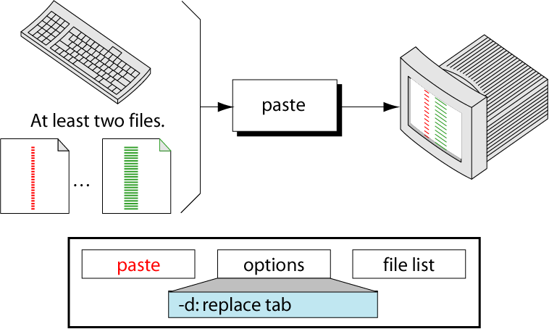
paste command
Paste combines the first line of the first file with the first line of the second file and writes the result to standard output.
It writes a tab between the columns and a new line character at the end of the last column. It continues with the next two lines.

Slide 26
paste command
Create the following three files to practice the examples:
$ cat file1
Unix
Linux
Windows
$ cat file2
Dedicated server
Virtual server
$ cat file3
Hosting
Machine
Operating system

Slide 27
paste command
Example 1: Merging files in parallel
By default, the paste command merges the files in parallel. The paste command writes corresponding lines from the files as a tab delimited on the terminal.
$ paste file1 file2
Unix Dedicated server
Linux Virtual server
Windows
$ paste file2 file1
Dedicated server Unix
Virtual server Linux
Windows

Slide 28
paste command
Example 2: Specifying the delimiter
Paste command uses the tab delimiter by default for merging the files. You can change the delimiter to any other character by using the -d option.
$ paste -d"|" file1 file2
Unix|Dedicated server
Linux|Virtual server
Windows|
In the above example, pipe delimiter is specified

Slide 29
paste command
Example 3: Specifying multiple delimiters.
Multiple delimiters come in handy when you want to merge more than two files with different delimiters. For example I want to merge file1, file2 with pipe delimiter and file2, file3 with comma delimiter. In this case multiple delimiters will be helpful.
$ paste -d"|," file1 file2 file3
Unix|Dedicated server,Hosting
Linux|Virtual server,Machine
Windows|,Operating system

Slide 30
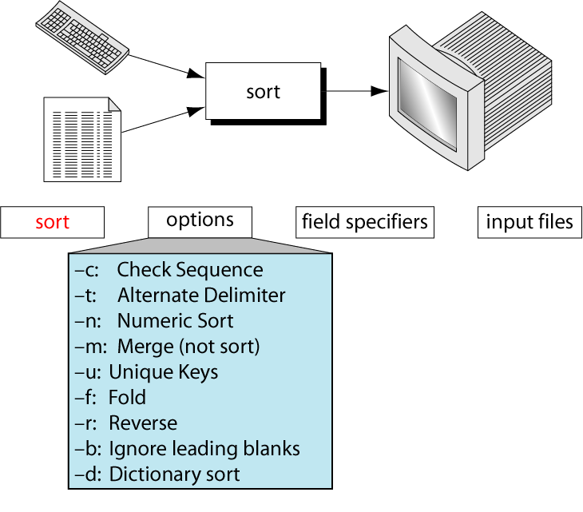
sort command
Used to sort a file, arranging the records in a particular order.
By default, the sort command sorts file assuming the contents are ASCII. Using options in sort command, it can also be used to sort numerically.

Slide 31
sort command
Let us consider a file with the following contents:
$ cat file
Unix
Linux
Solaris
AIX
Linux
HPUX

Slide 32
sort command
Example 1: Sort simply the file in alphabetical order:
$ sort file
AIX
HPUX
Linux
Linux
Solaris
Unix

Slide 33
sort command
Print unique record using (-u) option.
Example 2: Sort the file and display only unique record.
$ sort -u file
AIX
HPUX
Linux
Solaris
Unix
The duplicate 'Linux' record got removed. '-u' option removes all the duplicate records in the file. Even if the file have had 10 'Linux' records, with -u option, only the first record is retained.

Slide 34
sort command
Sort File with numbers:
Let us consider a file with numbers:
File | File 2
$ cat file 20 19 5 49 200 | $ cat file2 25 18 5 48 200

Slide 35
sort command
The default sort 'might' give incorrect result on a file containing numbers:
$ sort file
19
20
200
49
5
In the above result, 200 got placed immediately below 20, not at the end which is incorrect. This is because the sort did ASCII sort.
If the file had not contained '200', the default sort would have given proper result. However, it is incorrect to sort a numerical file in this way since the sorting logic is incorrect.

Slide 36
sort command
Sort Numerically using (-n) and in reverse using (-r) option
Example 3: Sort the numeric file OR Sort file numerically.
-r option is also use with text file to print record or data reversely.
Sorting in ASCENDING order | Sorting in DESCENDING order
$ sort –n file 5 19 20 49 200 | $ sort -nr file 200 49 20 19 5

Slide 37
sort command
Display Unique record using (-u) option
Example 4: Sort the multiple numeric file OR Sort , Merge and Remove duplicates from file
Sort Multiple files | Sort, Merge and Remove duplicates
$ sort –n file, file2 5 5 18 19 20 25 48 49 200 200 | $ sort -nu file 5 18 19 20 25 48 49 200

Slide 38
sort command
File with multiple fields and delimiter:
Let us consider a file with delimiter “,”.
By default delimiter is space.
File
$ cat file OM,20,SURAT,BCA,258307 SAI,19,BARDOLI,BBA,245678 RAM,5,NAVSARI,BBA,222434 VATSHAL,49,BARODA,BCA,258783 AADI,200,SURAT,BCA,264416

Slide 39
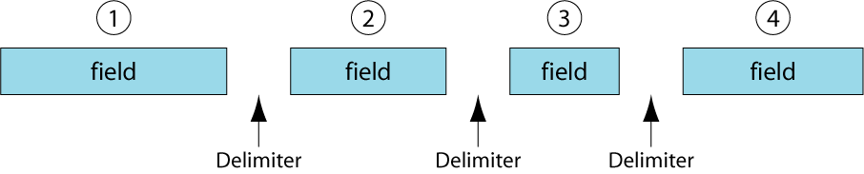
Fields Within A Line

Slide 40
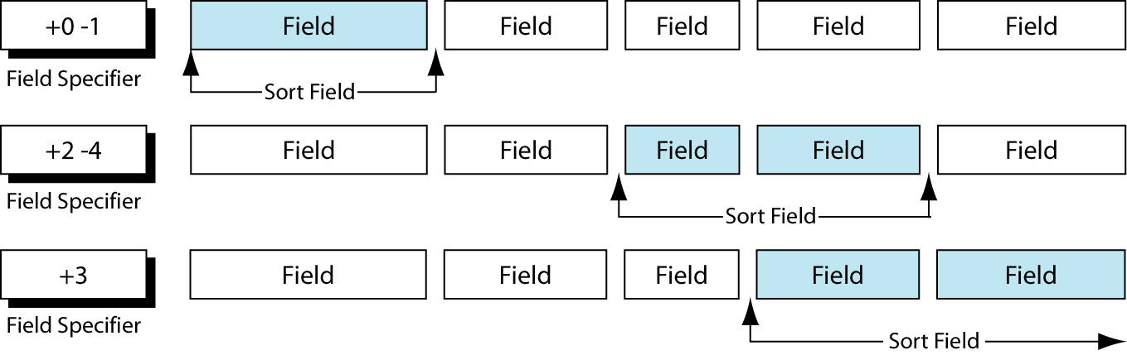
Field Specifier Examples

Slide 41
sort command
Sorting on Primary filed using (-k) key option:
Example 5: Sort the record in the file on primary field.
Sorting in ASCENDING order | Sorting in DESCENDING order | Sorting on NUMERIC Field
$ sort file OR $ sort -t"," -k1,1 file AADI,200,SURAT,BCA,264416 OM,20,SURAT,BCA,258307 RAM,5,NAVSARI,BBA,222434 SAI,19,BARDOLI,BBA,245678 VATSHAL,49,BARODA,BCA,258783 | $ sort -r file VATSHAL,49,BARODA,BCA,258783 SAI,19,BARDOLI,BBA,245678 RAM,5,NAVSARI,BBA,222434 OM,20,SURAT,BCA,258307 AADI,200,SURAT,BCA,264416 | $ sort –t”,” –k2n,2 file RAM,5,NAVSARI,BBA,222434 SAI,19,BARDOLI,BBA,245678 OM,20,SURAT,BCA,258307 VATSHAL,49,BARODA,BCA,258783 AADI,200,SURAT,BCA,264416 To reverser order. $ sort –t “,”-k2nr,2 file

Slide 42
sort command
'-t' option is used to provide the delimiter in case of files with delimiter.
'-k' is used to specify the keys on the basis of which the sorting has to be done.
The format of '-k' is : '-km,n'
where m is the starting key and n is the ending key.
In our case, since the sorting is on the 1st field alone, we speciy '1,1'.
Similarly, if the sorting is to be done on the basis of first 3 fields, it will be: '-k 1,3'.
if the sorting is to be done 2 and 4 field, it will be: '-k2, -k4'.
-k2,2 specifies sorting on the key starting and ending with column 2.
If -k2 is used instead, the sort key would begin at column 2 and extend to the end of the line, spanning all the fields in between.

Slide 43
sort command
'-t' option is used to provide the delimiter in case of files with delimiter.
'-k' is used to specify the keys on the basis of which the sorting has to be done.
The format of '-k' is : '-km,n'
where m is the starting key and n is the ending key.
In our case, since the sorting is on the 1st field alone, we speciy '1,1'.
Similarly, if the sorting is to be done on the basis of first 3 fields, it will be: '-k 1,3'.
if the sorting is to be done 2 and 4 field, it will be: '-k 2, -k4'.
-k2,2 specifies sorting on the key starting and ending with column 2.
If -k2 is used instead, the sort key would begin at column 2 and extend to the end of the line, spanning all the fields in between.

Slide 44
sort command
Sorting on Secondary filed using (-k) key option:
Example 6: Sort the record in the file on 3 field as primary field & 2 field as secondary key.
Sorting in ASCENDING order
$ sort -t"," –k 3,3 –k 2n,2 file SAI,19,BARDOLI,BBA,245678 VATSHAL,49,BARODA,BCA,258783 RAM,5,NAVSARI,BBA,222434 OM,20,SURAT,BCA,258307 AADI,200,SURAT,BCA,264416
You can sort on more than one key by providing secondary key.
In this situation, you need to specify for every –k option, where the sort ends.

Slide 45
sort command
Sorting on columns
Example 6: Sort the record in the file on the date of birth year.
You can specify a character position within a field to be the beginging of sort.
If you are to sort the file according to the year of birth, they you need to sort on the nineth and tenth column positions within the 6th field.
File | Sorting on Year of Birth
$ cat file OM|20|SURAT|BCA|258307|11/08/1997 SAI|19|BARDOLI|BBA|245678|10/12/1994 RAM|5|NAVSARI|BBA|222434|10/11/1991 VATSHAL|49|BARODA|BCA|258783|01/04/1992 AADI|200|SURAT|BCA|264416|07/02/1990 | $ sort -t“|" –k 6.9,6.10 file AADI|200|SURAT|BCA|264416|07/02/1990 RAM|5|NAVSARI|BBA|222434|10/11/1991 VATSHAL|49|BARODA|BCA|258783|01/04/1992 SAI|19|BARDOLI|BBA|245678|10/12/1994 OM|20|SURAT|BCA|258307|11/08/1997

Slide 46
uniq command
used to suppress the duplicate lines from a file.
It discards all the successive identical lines except one from the input and writes the output.
Syntax : uniq [option] filename
OPTION | MEANING
u | Select only unique lines.
d | Select duplicate lines.
c | Counting frequency of occurances.

Slide 47
uniq command
Suppress duplicate line
Example 1: Suppress duplicate lines from file
The default behavior of the uniq command is to suppress the duplicate line. Note that, you have to pass sorted input to the uniq, as it compares only successive lines.
File | Suppress duplicate line
$ cat file Unix operating system unix operating system unix dedicated server linux dedicated server | $ uniq file unix operating system unix dedicated server linux dedicated server

Slide 48
uniq command
Count of Lines
The -c option is used to find how many times each line occurs in the file. It prefixes each line with the count.
File | Suppress duplicate line
$ cat file Unix operating system unix operating system unix dedicated server linux dedicated server | $ uniq –c file 2 unix operating system 1 unix dedicated server 1 linux dedicated server

Slide 49
uniq command
Display only duplicate lines
You can print only the lines that occur more than once in a file using the -d option
File | Suppress duplicate line
$ cat file Unix operating system unix operating system unix dedicated server linux dedicated server | $ uniq –d file unix operating system

Slide 50
uniq command
Skip the N field in comparison
The -f option is used to skip the first N columns in comparison. Here the fields are delimited by the space character.
In the example the uniq command, just compares the last fields. For the first two lines, the last field contains the string "system". Uniq prints the first line and skips the second. Similarly it prints the third line and skips the fourth line.
File | Suppress duplicate line
$ cat file Unix operating system unix operating system unix dedicated server linux dedicated server | $ uniq –f2 file unix operating system unix dedicated server

Slide 51
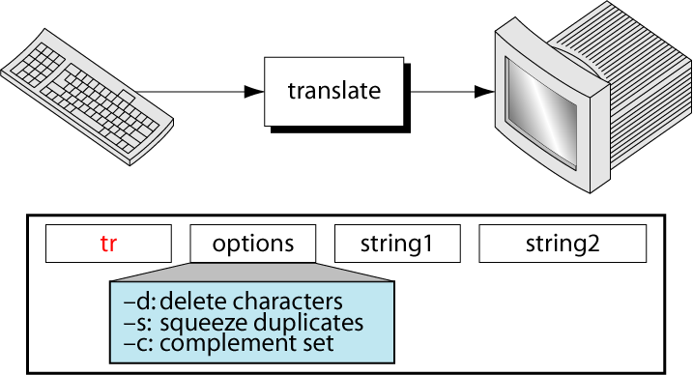
tr command
Used to replaces each character on a user-specified set of characters with a corresponding character in a second set.
It handling either entire lines or columns.
It takes input only from standard input ; it doesn’t take a filename as arguments.

Slide 52
tr command
It translates each characters in string1 to its mapped counterpart in string2.
The first character in the first string is replaced with the first character in the second expression and similarly for other characters.
Translating Characters
Example 1: Convert lower case to upper case
Test | Translating Test
$ cat test Thegeekstuff | $ tr abcdefghijklmnopqrstuvwxyz ABCDEFGHIJKLMNOPQRSTUVWXYZ OR $ tr [a-z] [A-Z] THEGEEKSTUFF

Slide 53
tr command
Example 2: Convert delimiter “|” to “,” and print only first 3 record.
File | Translating and print only 3 record.
$ cat file OM|20|SURAT|BCA|258307|11/08/1997 SAI|19|BARDOLI|BBA|245678|10/12/1994 RAM|5|NAVSARI|BBA|222434|10/11/1991 VATSHAL|49|BARODA|BCA|258783|01/04/1992 AADI|200|SURAT|BCA|264416|07/02/1990 | $ cat file | tr ‘|/’ ‘,-’ | head -3 OM,20,SURAT,BCA,258307,11-08-1997 SAI,19,BARDOLI,BBA,245678,10-12-1994 RAM,5,NAVSARI,BBA,222434,10-11-1991

Slide 54
tr command
Deleting Character using option (-d)
Example 2: Delete field delimiter and date delimiter and print only first 3 records
File | Translating and print only 3 record.
$ cat file OM|20|SURAT|BCA|258307|11/08/1997 SAI|19|BARDOLI|BBA|245678|10/12/1994 RAM|5|NAVSARI|BBA|222434|10/11/1991 VATSHAL|49|BARODA|BCA|258783|01/04/1992 AADI|200|SURAT|BCA|264416|07/02/1990 | $ tr -d ‘|/’ < file| head -3 OM20SURATBCA25830711081997 SAI19BARDOLIBBA24567810121994 RAM5NAVSARIBBA22243410111991
$ echo "the geek stuff" | tr -d 't'
he geek suff

Slide 55
tr command
Replace non-matching characters using option (-c) .
The -c option is used to replace the non-matching characters with another set of characters.
$ echo "unix" | tr -c "u" "a"
uaaa
Squeezing characters using option (-s)
You can squeeze more than one occurrence of continuous characters with single occurrence. The following example squeezes two or more successive blank spaces into a single space.
$ echo "linux server" | tr -s " "
linux server

Slide 56
Difference between Redirection, Pipe and Tee command
Redirection simply route the output to the files.
Pipe route the output to the other programs.
But if we want output in file as well as programs, we have to use “tee” command.
Tee command read the standard input and send it on the standard output. It also redirects copy of what it has read into file of your choice.
For example: who | tee logfile | sort
Output of who becomes the standard input of tee. Tee now send copy of input to sort through pipeline whereas the other copy is stored in the file called logfile.
For example: who | tee logfile1 logfile2 | sort
Output of who command is store into two file logfile1, logfile2 and also inputed into sort command.

Slide 57
Difference between Redirection, Pipe and Tee command
If we want to store the output in 2 file , display the same output on the screen and store the sorted output on file3 we use following command.
For example: who | tee logfile1 logfile2 /dev/tty3| sort >file3
Output of who command is store into two file logfile1, logfile2 and also display on the screen using the file associated with our terminal. Hence it send output of who to 2 file as well as on the screen. It input output to sort command and output of sort command is redirect to file3

Slide 58
Redirection Vs. Piping
REDIRECTION | PIPING
Redirection is the process by which we specify that a file is to be used in place of one of the standard files. | Pipe is an operator that temporarily saves the output of one command in a buffer that is used at the same time as an input of the next command.
It connects command to the file. | It connect command to other commands.
For Example: Check following who command which would redirect complete output of the command in users file. $ ls > files.txt | For Example: Following command count the number of line in apple.txt file using pipe. $ cat apple.txt | wc 3 4 21 Here output of cat command becomes input of wc command using pipe.
Route output to files | Route output to other programs.

